Slide 1



  Problem Statement Title – AI Chatbot for Career and Skills advisor.
  Theme – Education for India
  Tagline – “Your AI Mentor for Smarter Career Choices”
  PS Category - Software
  Team Name - Tech Titans.
  Team Members – Shivam Kawatra (Leader), Arpit Sharma, Abhishek Kumar Gupta & Kshitij Varshney.
OPEN AI ACADEMY X NXT WAVE BUILDATHON

Slide 2
PROBLEM STATEMENT
Students struggle to:
    Select the right specialization in CSE (AI/ML, DS, Cybersecurity, etc.).
    Identify a clear step-by-step skill roadmap.
    Find authentic free/paid resources among scattered options online.
Career counseling services are limited, expensive, or generic.
Need for a 24×7 digital advisor that is personalized & scalable.

Slide 3
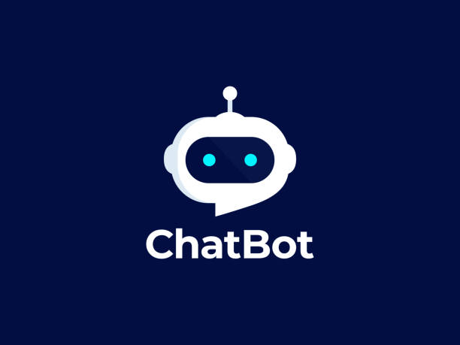

PROPOSED SOLUTION
A Chatbot powered by AI that:
Acts as a personal career mentor.
Provides structured roadmaps for different CSE fields.
Suggests curated online resources (MOOCs, YouTube, GitHub projects).
Answers career-related queries instantly.
Designed for OpenAI API integration.
Prototype built with Hugging Face for free testing & demo.
Helps students make smarter career decisions without needing expensive career counseling.

Slide 4

Features & Scope
Personalized Q&A: Career queries answered dynamically.
Interactive Roadmaps: Step-by-step path to become Data Scientist, AI Engineer, Cybersecurity Analyst, etc.
Resource Recommendation: Free platforms (Kaggle, Coursera, edX, YouTube) + premium options.
Feedback System: Complaint & suggestion form for improvement.
Ease of Use: Simple UI with Gradio + Web frontend.
Scalable: Easily extendable to voice, resume analysis, placement support.

Slide 5
TECH STACK
FRONTEND
BACKEND
AI LAYER
Gradio (for chatbot UI)
HTML, CSS, JavaScript (landing page & integration)
Node.js + Express.js (API layer)
MongoDB (user queries, feedback, history)
Target (final deployment): OpenAI API (ChatGPT-style models)
Prototype (demo): Hugging Face Transformers (Roberta-base model) using Python

Slide 6
THANK YOU

